Slide 1
Basics of Memories

Slide 2
Lecture 44 Basic concepts of Concepts of PLA and PAL
Lecture delivered by:
Deepak V.

Slide 3
Objectives
At the end of this lecture, student will be able to:
Acquire the knowledge of programmable logic array
Acquire the knowledge of programmable array logic

Slide 4
Topics
PLA
PAL

Slide 5
Array Logic
Array logic has two major forms:
Programmable logic devices (PLDs)
Field programmable gate arrays (FPGAs)
Programmable logic devices (PLDs)
These are examples of uncommitted logic
Forms include:
PLA – programmable logic array
PAL – programmable array logic
GAL – generic array logic
EPLD – erasable programmable logic device
CPLD – complex programmable logic device

Slide 6
Programmable logic array (PLA)
Has an array of inverters, AND gates and OR gates
Can implement any logic function (given limits on numbers of inputs and outputs)
Example: consider a system with four inputs A, B, C and D and three output X, Y and Z, where

Slide 7
Programmable Logic Array (PLA)
Use to implement circuits in SOP form
The connections in the AND plane are programmable
The connections in the OR plane are programmable
x
1
x
2
x
n
Input buffers
and
inverters
x
1
x
1
x
n
x
n
P
1
AND plane
OR plane
P
k
f
f
1
m

Slide 8
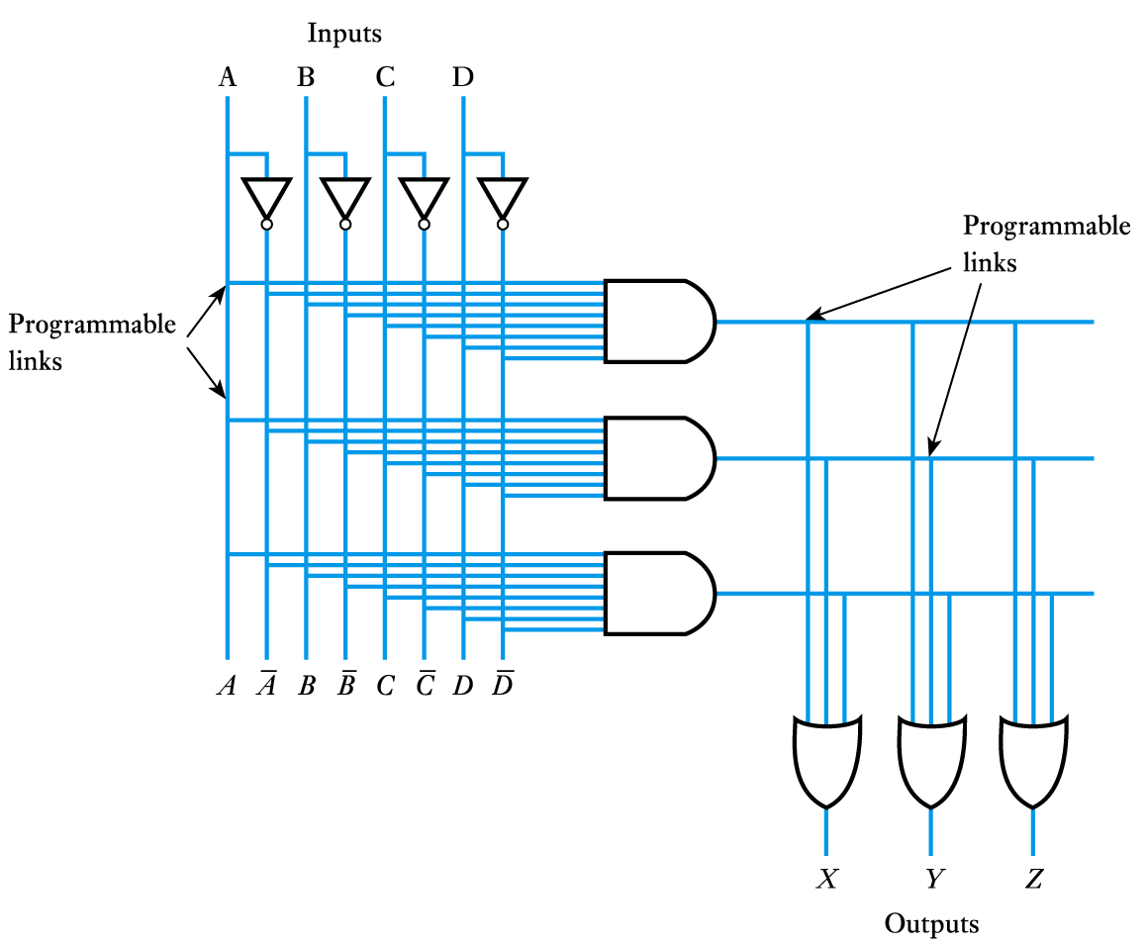
The structure of a simple PLA

Slide 9
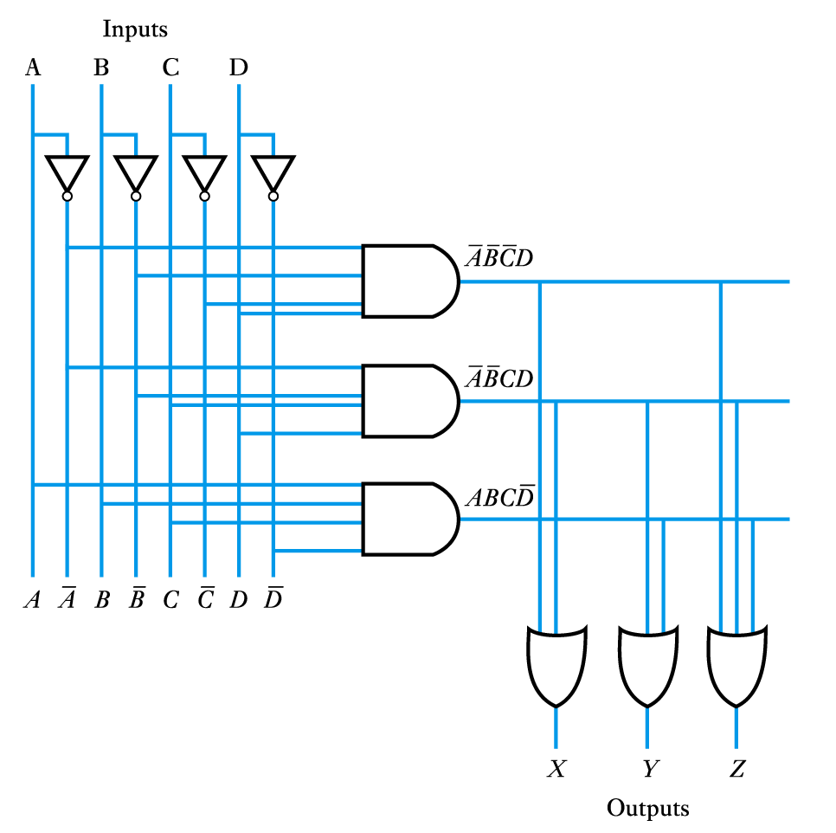
Contd..
The PLA programmed to give the required output functions
The device is programmed by blowing fusible links at the various interconnection points

Slide 10
Limitations of PLAs
PLAs come in various sizes
Typical size is 16 inputs, 32 product terms, 8 outputs
Each AND gate has large fan-in → this limits the number of inputs that can be provided in a PLA
16 inputs → 3¹⁶ = possible input combinations; only 32 permitted (since 32 AND gates) in a typical PLA
32 AND terms permitted → large fan-in for OR gates as well
This makes PLAs slower and slightly more expensive than some alternatives to be discussed shortly
8 outputs → could have shared minterms, but not required

Slide 11
Programmable Array Logic (PAL)
x
1
x
2
x
n
Also used to implement circuits in SOP form
The connections in the AND plane are programmable
The connections in the OR plane are NOT programmable
Input buffers
and
fixed connections
inverters
x
1
x
1
x
n
x
n
P
1
AND plane
OR plane
P
k
f
f
1
m

Slide 12
Example Schematic of a PAL
x
x
x
1
2
3
f₁ = x₁x₂x₃'+x₁'x₂x₃
f₂ = x₁'x₂'+x₁x₂x₃
P
1
f
1
P
2
P
3
f
2
P
4
AND plane

Slide 13
Comparing PALs and PLAs
PALs have the same limitations as PLAs (small number of allowed AND terms) plus they have a fixed OR plane → less flexibility than PLAs
PALs are simpler to manufacture, cheaper, and faster (better performance)
PALs also often have extra circuitry connected to the output of each OR gate
The OR gate plus this circuitry is called a macrocell

Slide 14
Summary
Array logic has two major forms:
Programmable logic devices (PLDs)
Field programmable gate arrays (FPGAs)
PLA has an array of inverters, AND gates and OR gates
PLA’s are used to implement circuits in SOP form
PAL’s are also used to implement circuits in SOP form
PALs are simpler to manufacture, cheaper, and faster (better performance)

